Slide 1
Mortality Prediction Using Temporal COVID-19 Health Data
CS 842 (introduction to data science)
by
Performance.AI
Samuel Anwo & David Akinmade
DATE Feb 15, 2021

Slide 2
Outline
Introduction
Problem statement
Distribution of Project work
Tools
Methodology
Model Productionization
Business value
References

Slide 3
Introduction
Covid-19 disease is caused by a new type of coronavirus named “SARS-Cov-2”
It is a serious acute respiratory condition that could be fatal and consists of varying symptoms like dry cough, fever, weakness, headache, muscle aches, diarrhea, loss of taste and breath, etc.
Important steps to help limit the spread of the disease include utilizing facial masks to cover the nose, properly social distancing, and cleaning hands with sanitizers etc.

Slide 4
Problem Statement
Build a classification model able to predict whether an inpatient or outpatient diagnosed with Covid-19 disease will die or survive.
Build a regression model to estimate the period (number of days) it takes for a patient diagnosed with the disease to die.

Slide 5
Distribution of Project work
Section of Project work | Student
Collection of dataset and Exploratory Data Analysis | Samuel
Data pre-processing and Feature selection | Samuel
Data transformation | David
Modelling (Classification) | David
Modelling (Regression) | Samuel
Model Evaluation and Results collation | David & Samuel
Model Productionization | David

Slide 6
Tools & resources
Programming Language - Python 3.8
Development IDE - Jupyter Notebook, Google Colab, Spyder,
Algorithm dev: Sci-kit learn, Keras, Tensorflow
Result Visualization - Matplotlib, Seaborn
Code/Model Productionization - Flask, Heroku

Slide 7
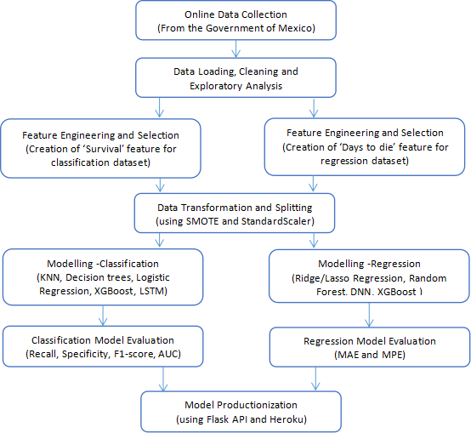
Methodology
Figure 1: High level schematic of the entire project methodology

Slide 8
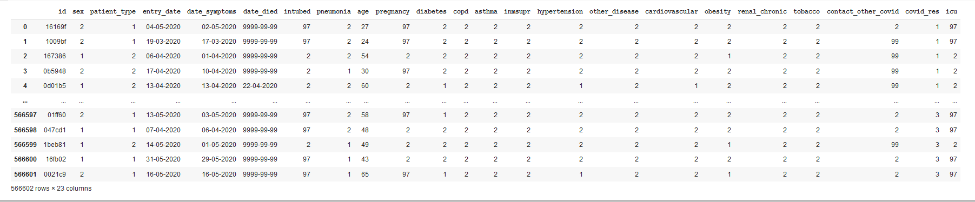
Discovery
The data to be used for this project is the COVID-19 Patient data provided by the Government of Mexico
It contains 566602 rows and 23 columns
Data size is 45 MB
Data set was uploaded to Jupyter notebook using Pandas
Fig 2: Raw dataset acquired

Slide 9
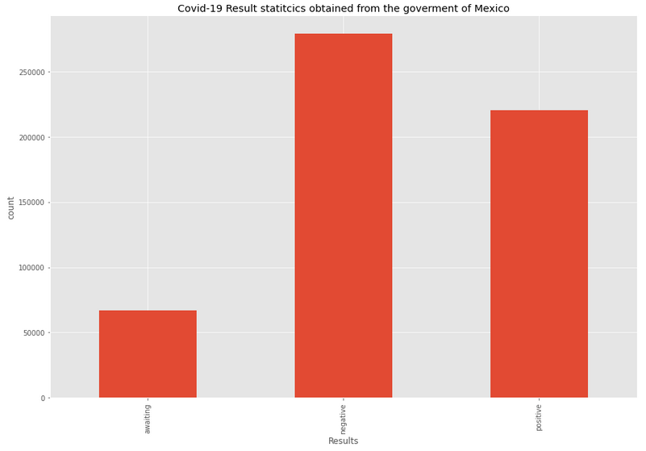
Discovery

Slide 10
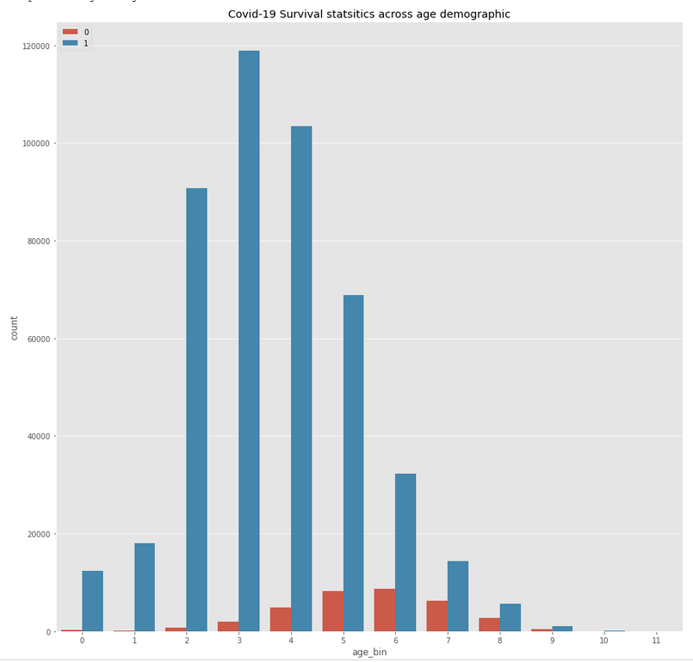
Discovery

Slide 11
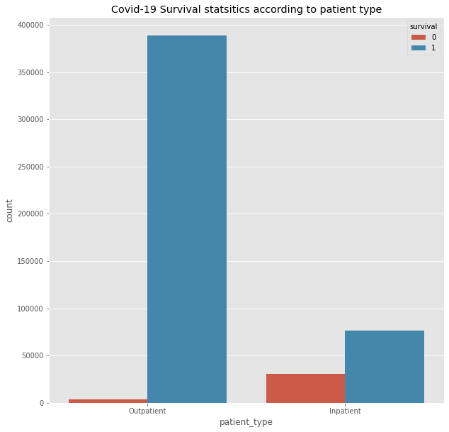
Discovery

Slide 12
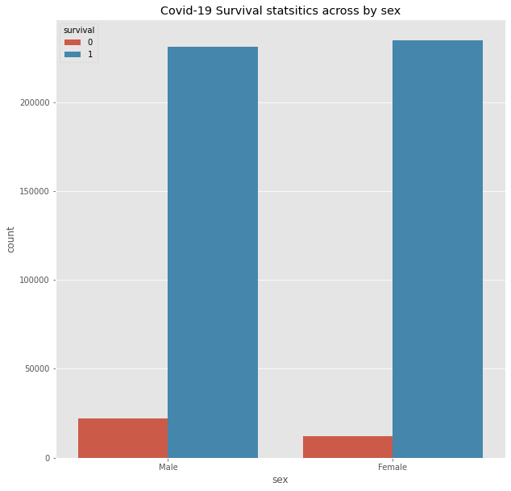
Discovery

Slide 13
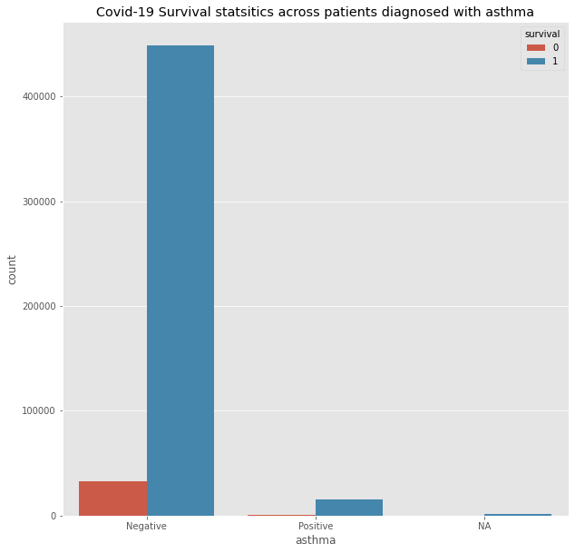
Discovery

Slide 14
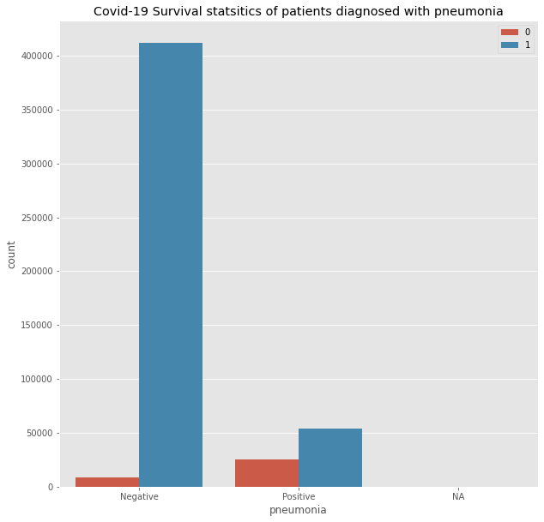
Discovery

Slide 15
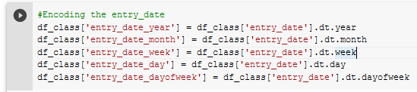
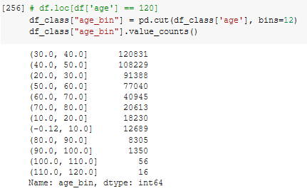
Data Preparation
Date–time features encoding
Binning for “Age” feature

Slide 16
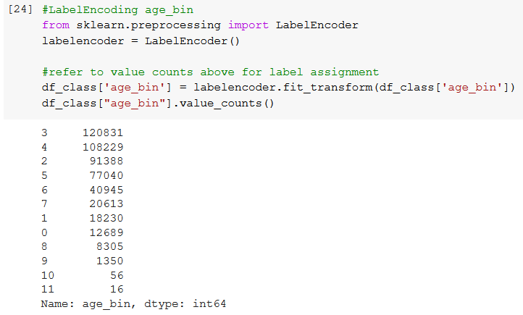
Data Preparation
  Label encoding

Slide 17

Data Preparation
  Create new features:
    Days to Die
    Survival
  Locate and replacing null & duplicate values

Slide 18
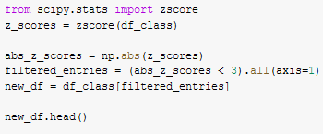
Data Preparation
  Outlier detection using Zscore
  Normalization and standardization using the StandardScaler
  Classifcation Dataset size: 399,753 rows
  Regression Dataset size: 24,315 rows
Fig : Removing datapoints that fall outside 3sd

Slide 19
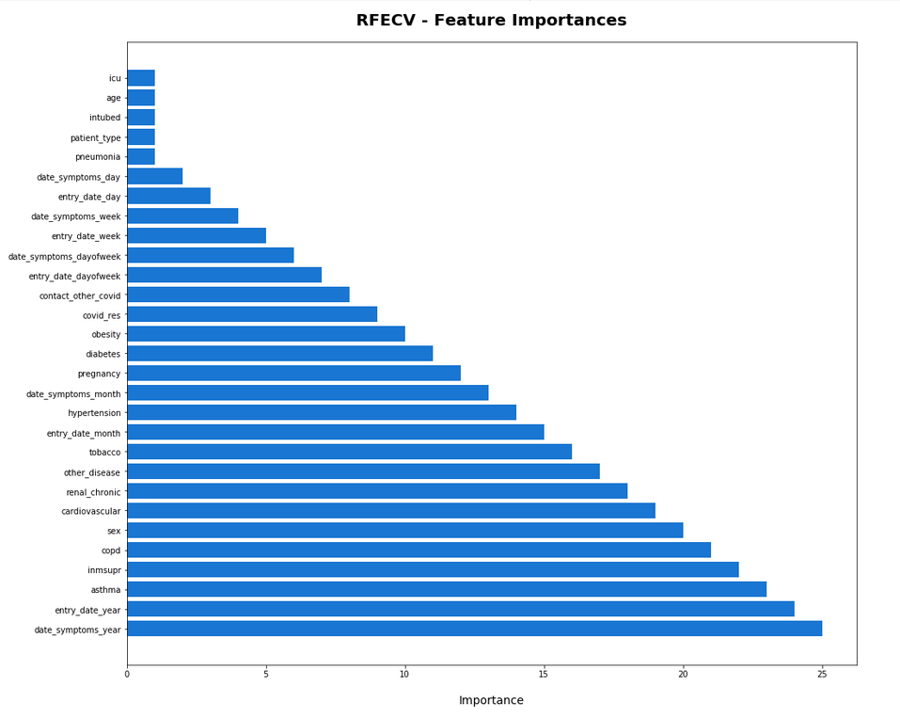
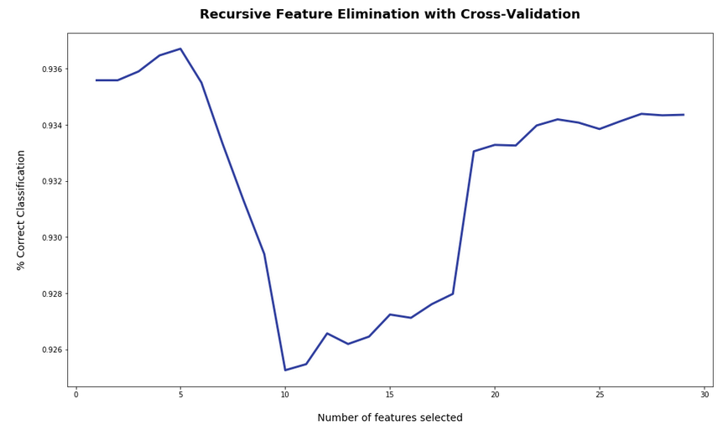
Model Planning
  Cross Validated Recursive Feature Elimination model (RFECV) for Feature Engineering
  Target feature “Survival”

Slide 20
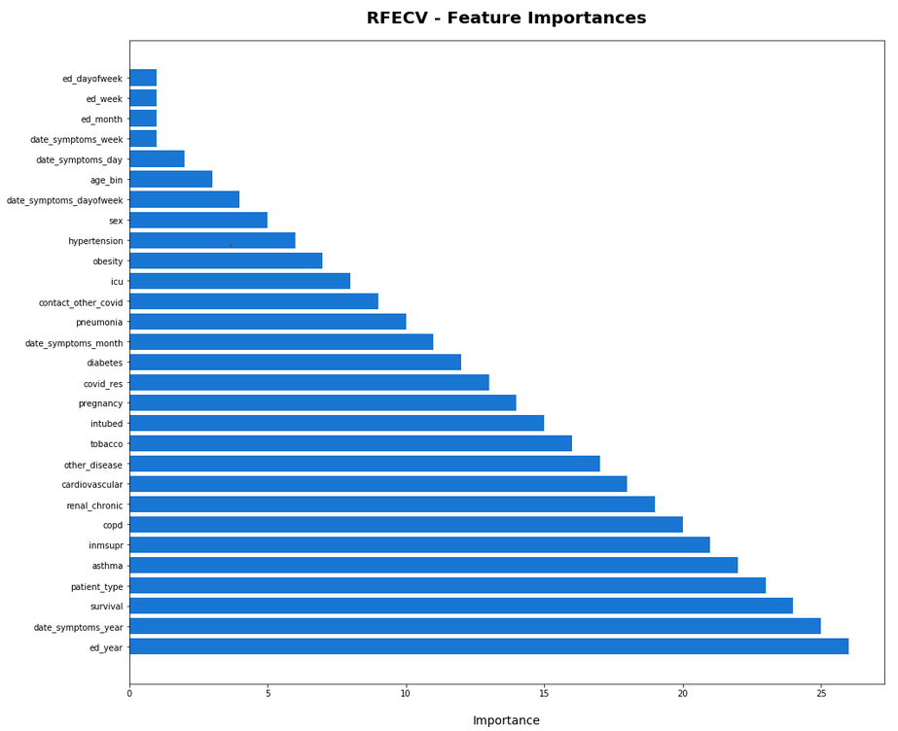
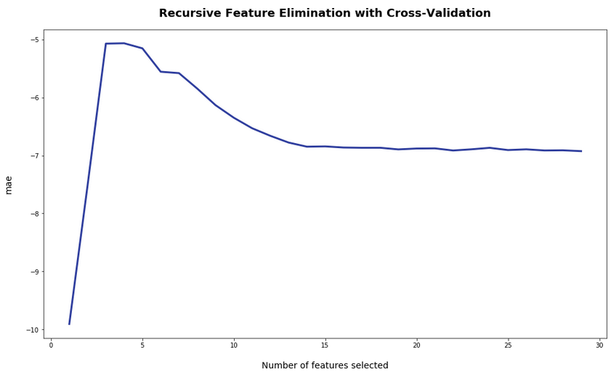
Model Planning
  Cross Validated Recursive Feature Elimination model (RFECV) for Feature Engineering of the Regression data set
Target feature ‘’Days to die’’

Slide 21
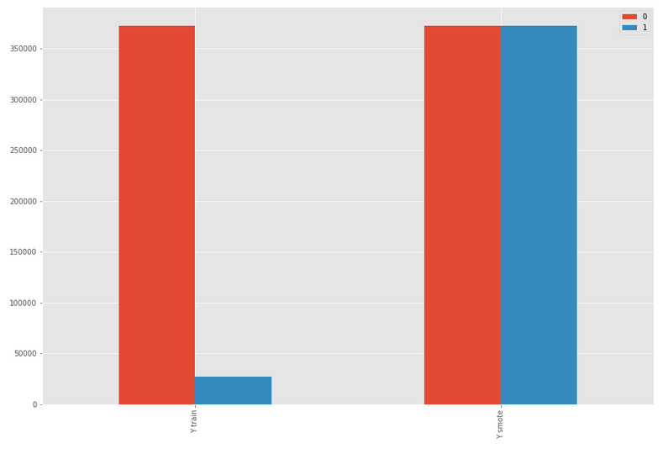
Model Building
Application of Smote to the Classification dataset
Fig : Representation of the model before and after SMOTE

Slide 22
Model Building
  Split the dataset (Classification and Regression) into train set and test set (80:20)
  Implemented using Train_test_split from Scikit-Learn

Slide 23
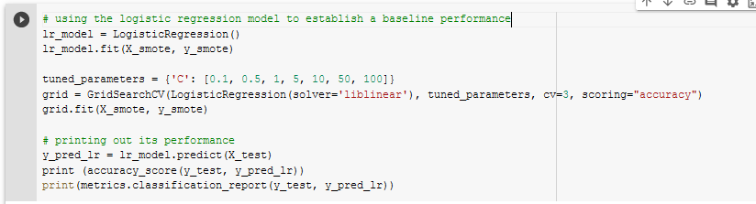
Model Building
  Apply Grid search, train baseline and deep learning models
Fig : Fitting GridSearch CV on a model

Slide 24
Model evaluation & Results
  Classification Model
Algorithm | Accuracy (AUC) | Precision |  | Recall |  | F1 Score
 |  | 0 | 1 | 0 | 1 | 0 | 1
Logistic Regression | 0.88 | 0.35 | 0.99 | 0.90 | 0.87 | 0.50 | 0.93
KNN | 0.89 | 0.35 | 0.98 | 0.76 | 0.90 | 0.48 | 0.94
Decision Tree | 0.92 | 0.44 | 0.97 | 0.63 | 0.94 | 0.52 | 0.96
XGBoost | 0.94 | 0.53 | 0.97 | 0.59 | 0.96 | 0.56 | 0.97
CATBoost | 0.91 | 0.41 | 0.98 | 0.81 | 0.92 | 0.55 | 0.95
LSTM | 0.89 | 0.38 | 0.99 | 0.86 | 0.90 | 0.53 | 0.94

Slide 25
Model evaluation & Results
  Regression Model
Algorithm | Mean Absolute Error
Linear Regression | 5.55
Ridge Regressor | 5.55
Random Forrest Regressor | 5.12
XGBoost Regressor | 5.09
Decision Tree Regressor | 6.13
RNN | 6.52
LSTM | 5.92

Slide 26
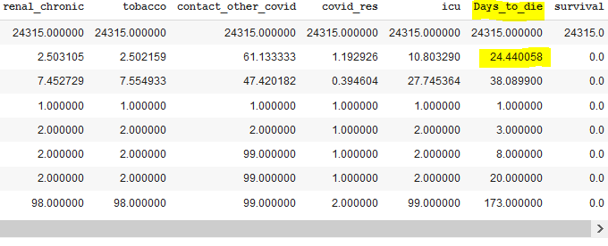
Model evaluation & Results
  Regression Model
Fig : Mean number of days deceased patients spent before dying

Slide 27
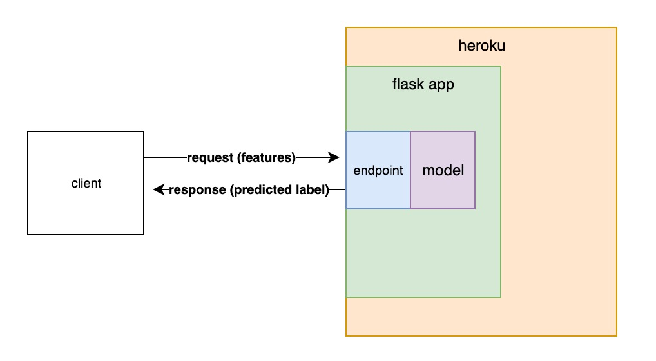
Model Productionization
  Implementation using one of the following methods:
  Deploying flask API on Heroku
Figure 2: SChematics of the productionized model [3]

Slide 28
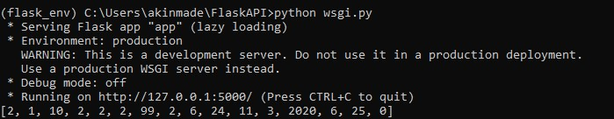
Model Productionization
Query
Response

Slide 29
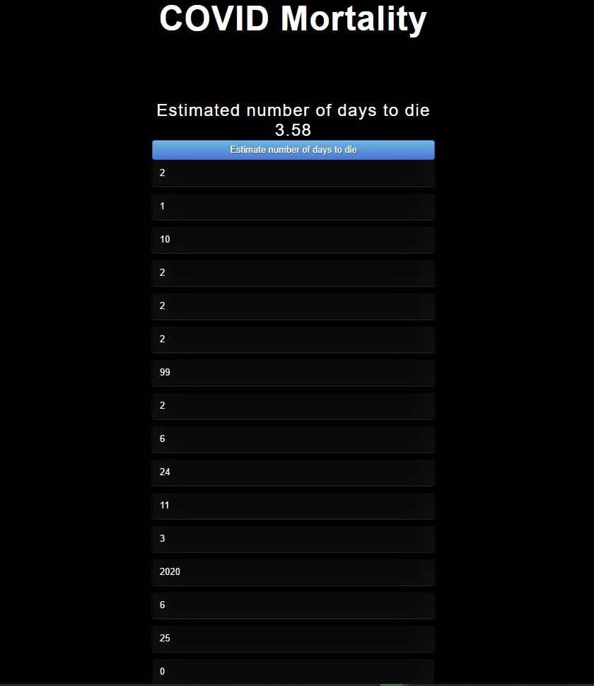
Model Productionization
  User Interface

Slide 30
Business Value & Relevance
This tool would enable high level practitioners in the medical profession make better decisions in how they should allocate resources for optimum level of attention to infected patients, and instructing Covid-19 vaccination process in the country.
Doctors can estimate how fast they need to act to save the lives of patients more likely to die sooner than others who are less at risk.
It would potentially help thousands of publicly and privately owned hospitals in Mexico process millions of temporal COVID-19 data

Slide 31
References
[1] Z. Malki, E.-S. Atlam, A. E. Hassanien, G. Dagnew, M. A. Elhosseini, and I. Gad, “Association between weather data and COVID-19 pandemic predicting mortality rate: Machine learning approaches,” Chaos, Solitons & Fractals, 17-Jul-2020.
[2] Jarndal, A., Husain, S., Zaatar, O., Gumaei, T. A., & Hamadeh, A. (2020). GPR and ANN based Prediction Models for COVID-19 Death Cases. 2020 International Conference on Communications, Computing, Cybersecurity, and Informatics (CCCI). doi:10.1109/ccci49893.2020.9256564
[3] 7.I., C. (2019, December 09). Productionize a machine learning model with Flask and Heroku. Retrieved February 15, 2021, from https://towardsdatascience.com/productionize-a-machine-learning-model-with-flask-and-heroku-8201260503d2

Slide 32
Thank You

